Slide 1

What is HTML?

Slide 2

What is HTML?
When a team of builders begin constructing a building.
One of their key tasks is to assemble the frame.
It doesn't matter what kind of building it is, it always starts with a frame of beams and rafters.
Once in place, the frame guides the rest of the construction.

Slide 3
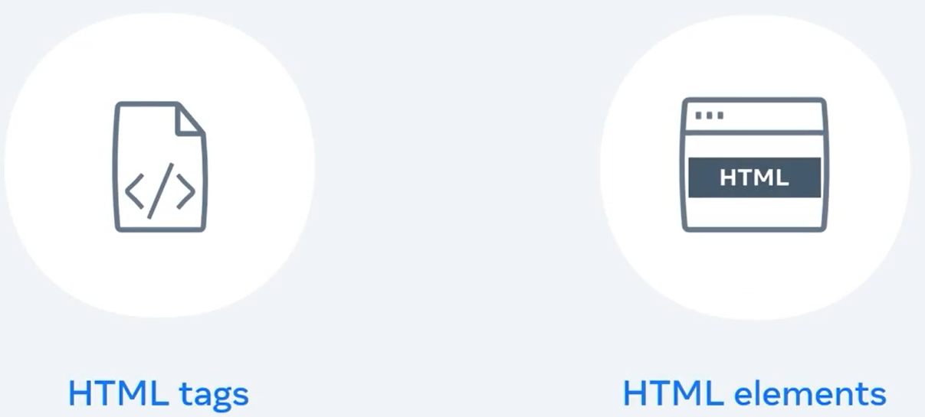
What is HTML?
If you compare abuilding with a web page, an HTML document is a lot like the frame.
It's a basic structure assembled with different components such as tags and elements.

Slide 4
What is HTML?
In this lecture, you will learn about HTML documents and the difference between HTML tags and elements.
To begin, let me tell you a short story about where it all started.

Slide 5
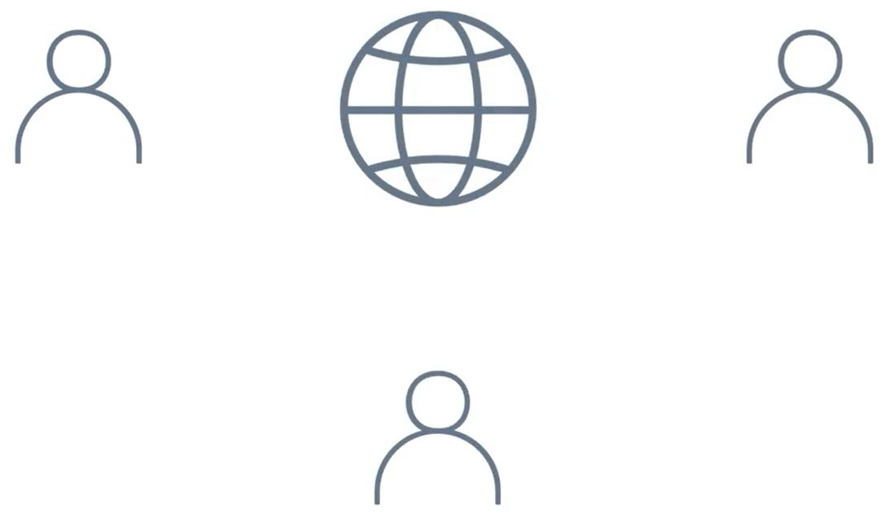

What is HTML?
Sir Tim Berners-Lee, a physicist, often thought about how he and his colleagues from around the world would share information.

Slide 6
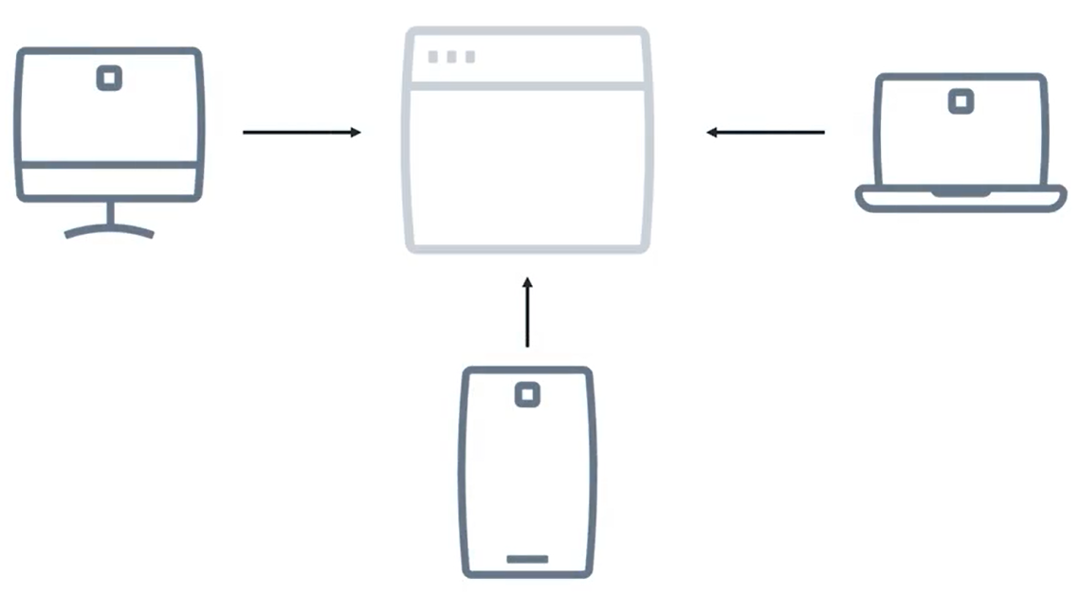
What is HTML?
He was so used to browsing information online that it might seem a silly thing to ponder about.
Actually, that question was very relevant at the time and started the development of HTML.

Slide 7
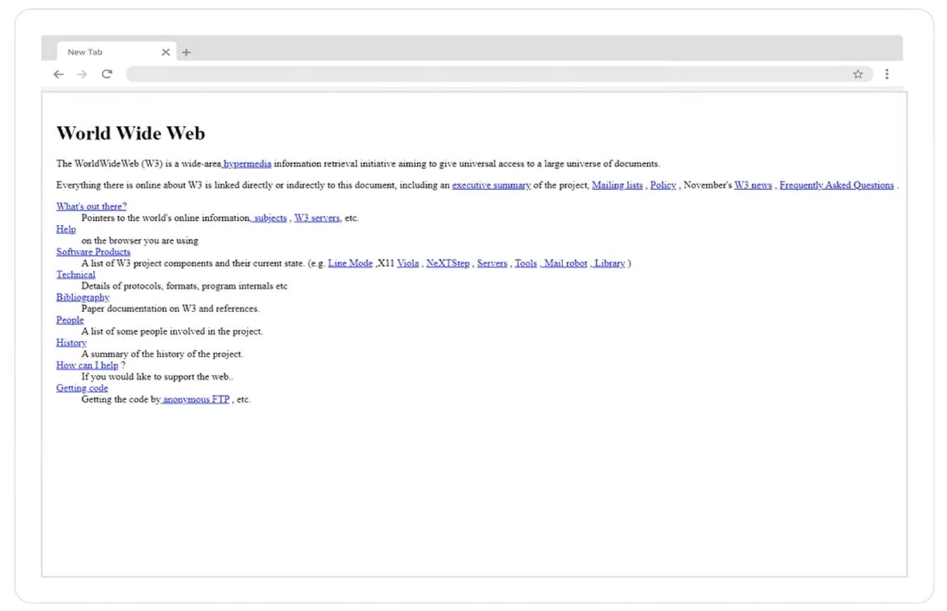
What is HTML?
Would you like to explore the very first web page?
The first web page was created in 1999 by Sir Tim Berners-Lee.
He worked at the European Organization for Nuclear Research or CERN, and originally proposed HTML.

Slide 8
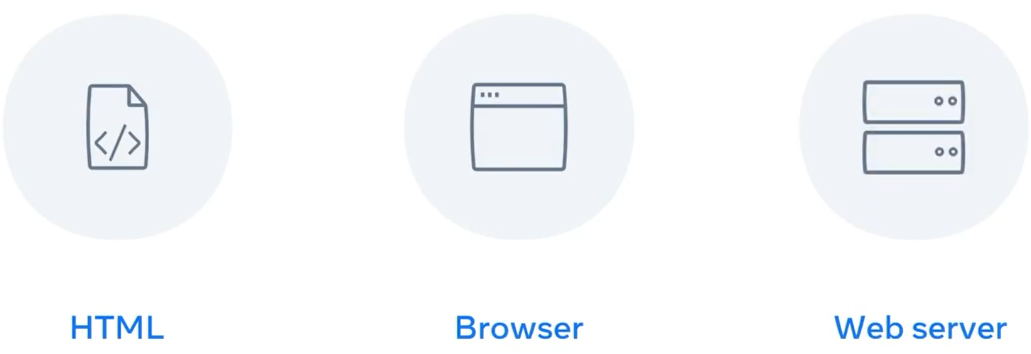
What is HTML?
The first version of HTML was released in 1991 along with the first web browser and web server.

Slide 9
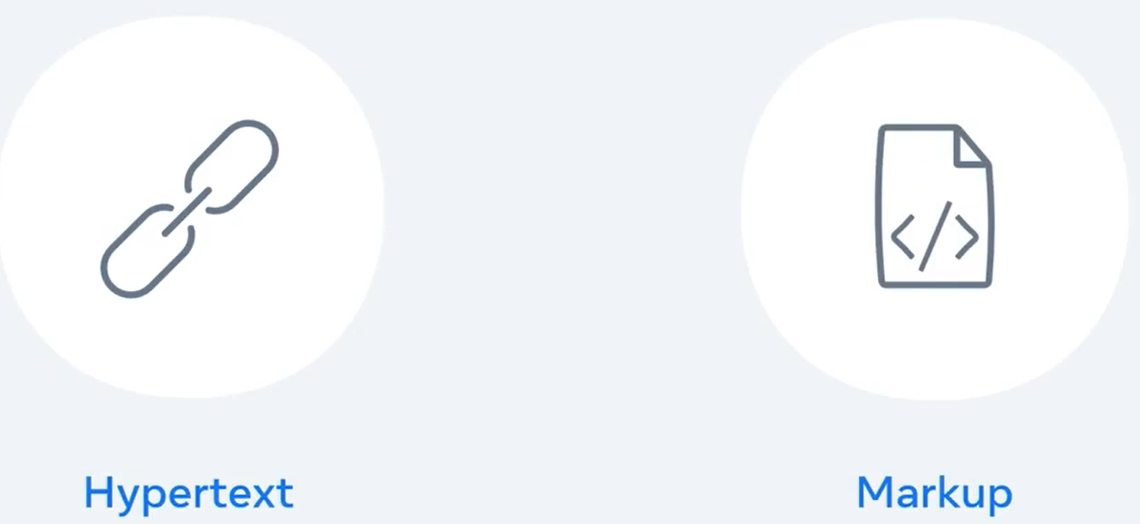
What is HTML?
HTML stands for Hypertext Markup Language. But what does that mean exactly?
Hypertext is text which contains links to other text.
Markup refers to tags and elements used within a document.
For now, let's just focus on some of the basics of HTML.

Slide 10
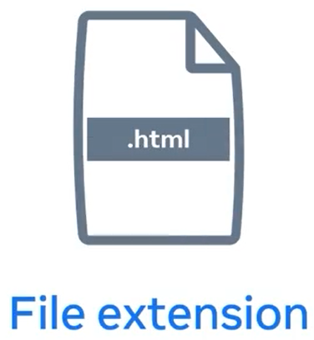
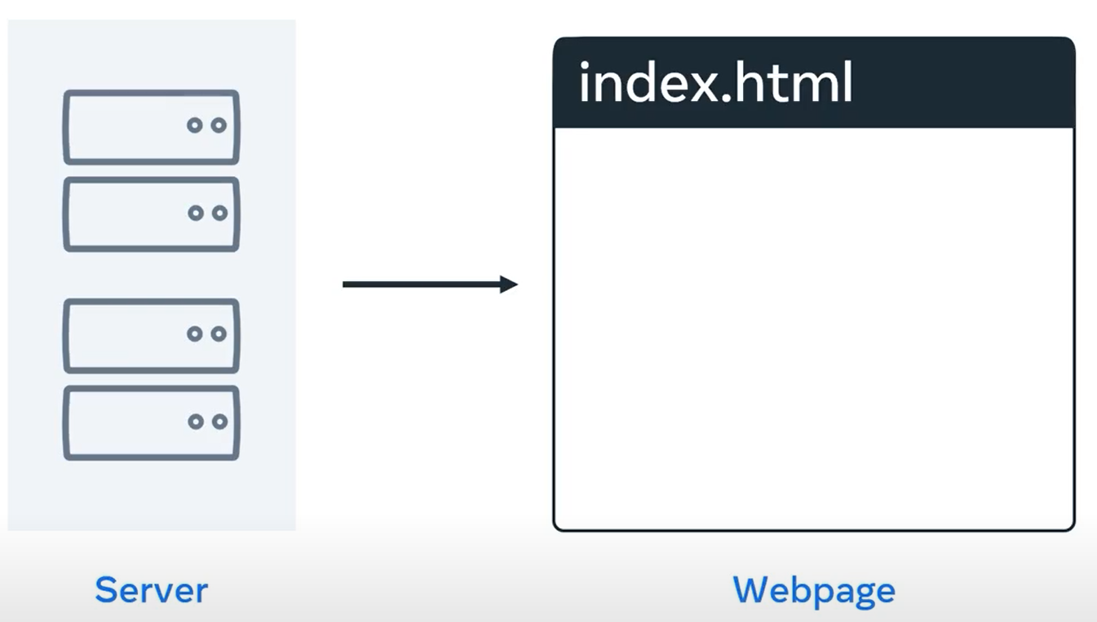
What is HTML?
HTML is simply a text file with a specific structure that consists of elements and tags.
Also take note that HTML files usually have a dot HTML suffix.
For instance, when you visit a website, the first page that is returned to the browser is often called index.html.
Now, let's explore what HTML tags and elements are.

Slide 11
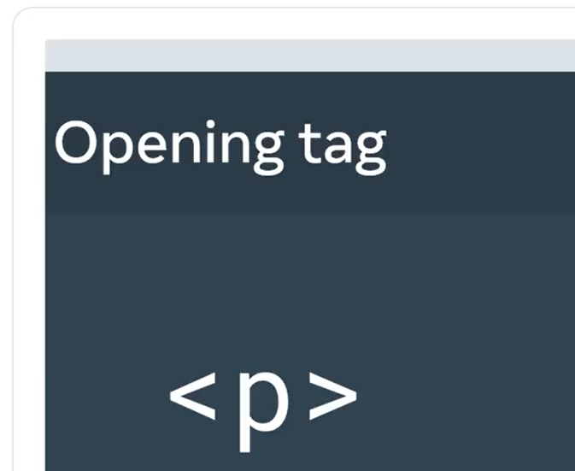
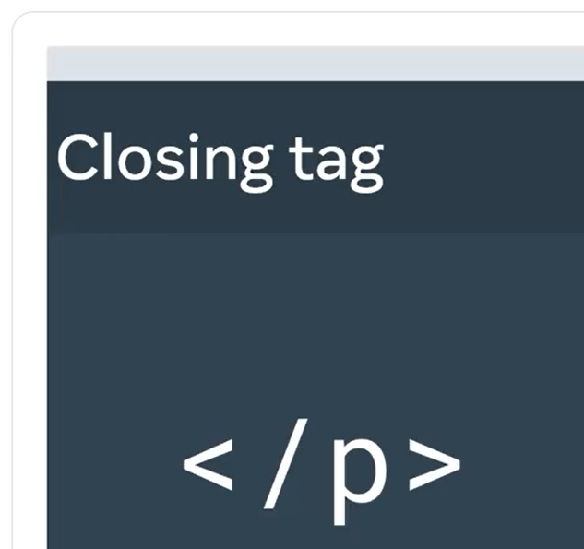
What is HTML?
Each HTML element consists of an opening tag enclosed in angle brackets.
For example, to create a paragraph, you type <p> for paragraph.
Most elements are paired with a closing tag, which has a forward slash off to the left angle bracket. For example, you close the paragraph element with </p>.

Slide 12
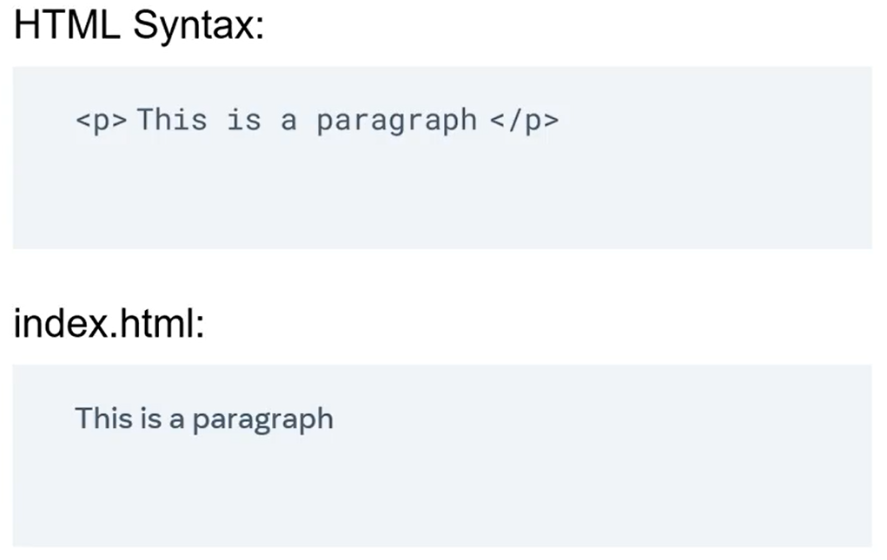
What is HTML?
HTML elements usually have some content inside them.
For example, between the opening and closing tags of a paragraph, you add the text of the paragraph
you want to write.

Slide 13
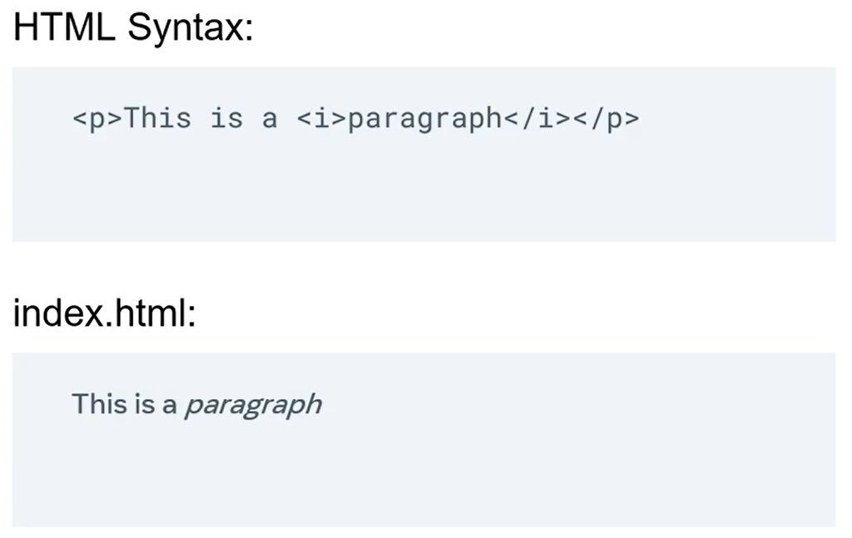
What is HTML?
HTML elements can also contain other elements.
For example, you can add an italics element inside a paragraph element to make texts appear in italics.

Slide 14
What is HTML?
But elements can also be empty or self-closing, meaning they do not have a closing HTML tag.
One example of a self-closing element is the line break tag.
You can add a line break tag in a paragraph tag to move content to the following line by typing <br>.

Slide 15
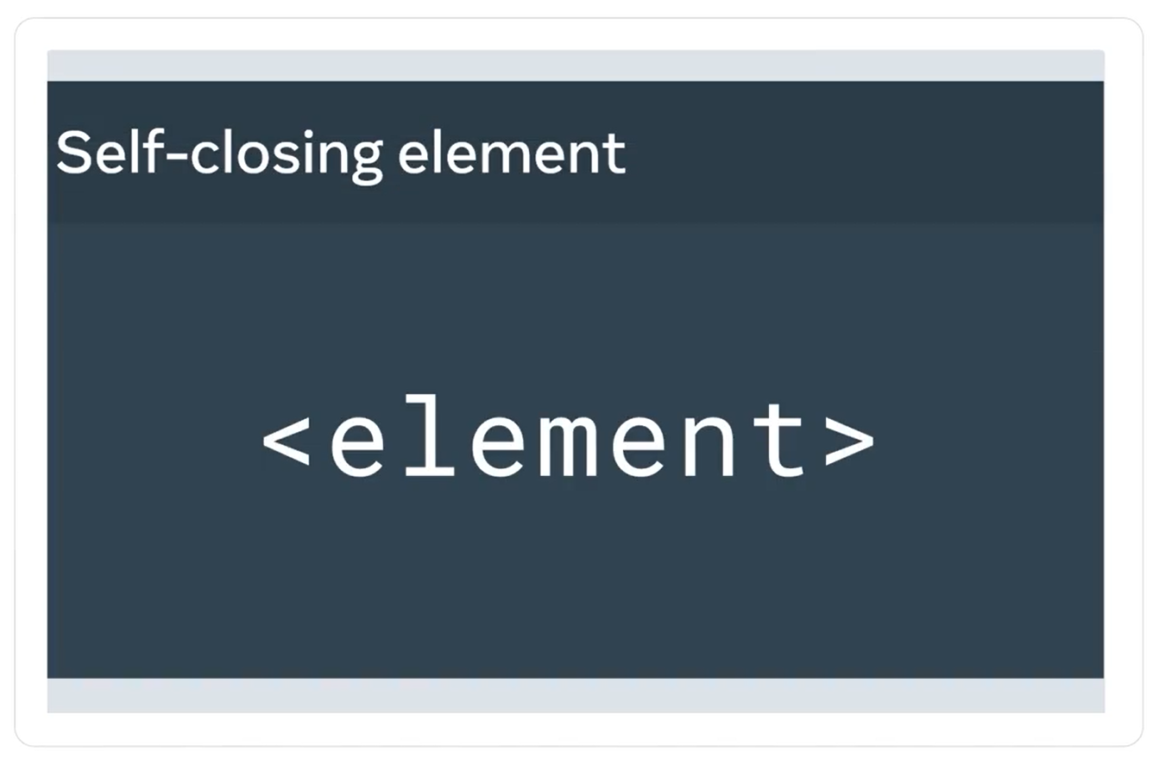
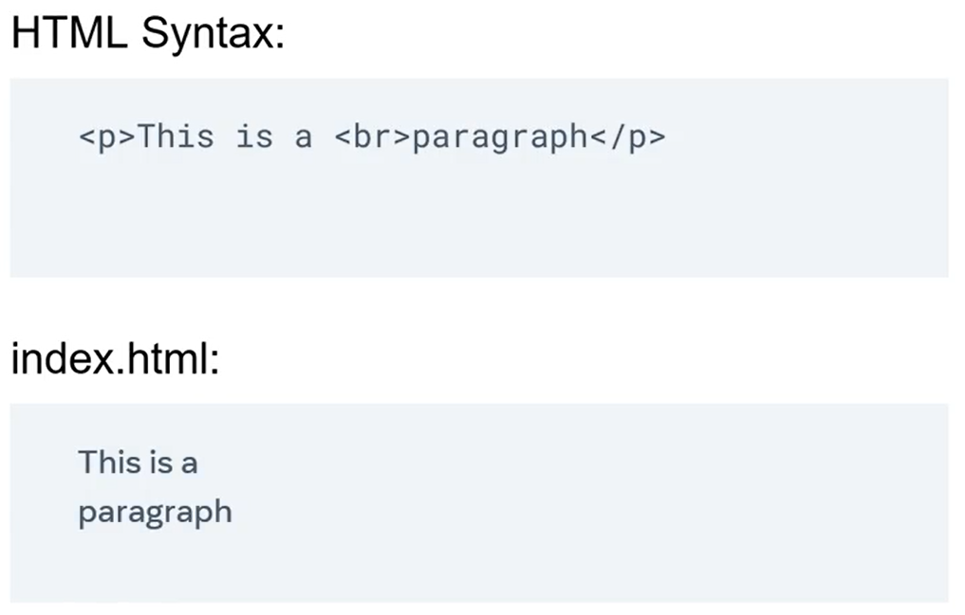
What is HTML?

Slide 16
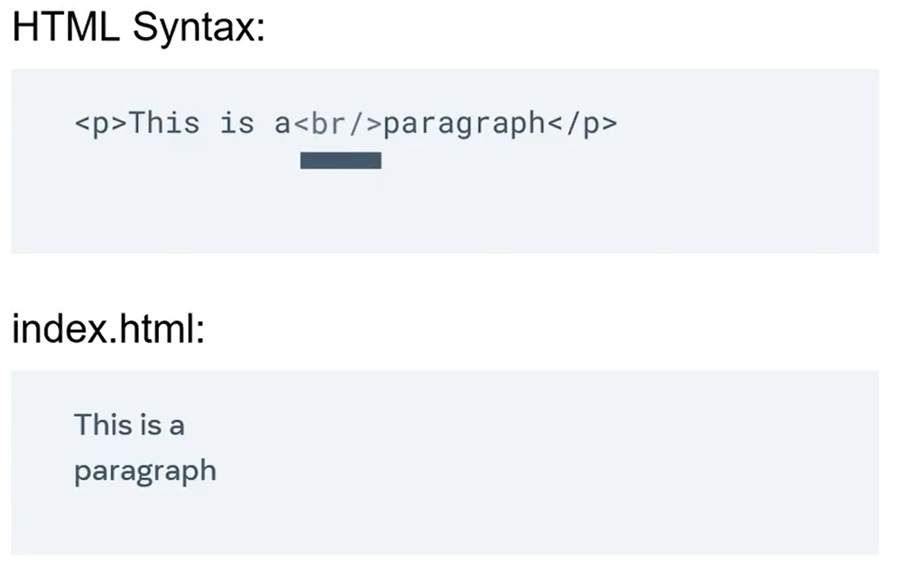
What is HTML?
At the end of a self-closing tag, you simply add a right angle bracket.
You can also close the right angle bracket by typing a forward slash right before it.
Now that you know what elements
and tags are, you will explore
what HTML standards are.

Slide 17
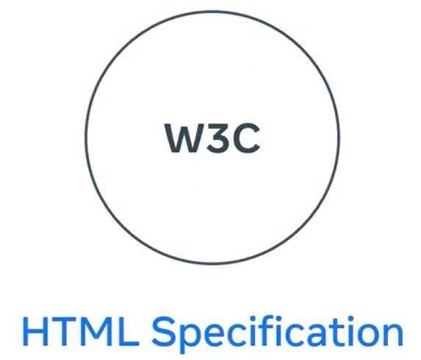
What is HTML?
The rules and structure for elements and tags are known as the HTML specification.
The HTML specification is maintained by the World Wide Web Consortium, or W3C as it is commonly known.

Slide 18
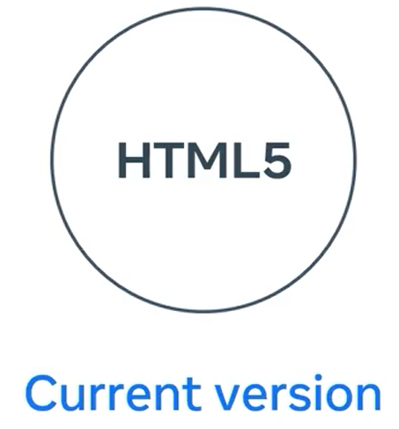
What is HTML?
Whenever the HTML specification changes a new version of HTML is standardized, the current version is HTML 5.
To summarize, HTML elements with their opening and closing tags in angle brackets buildup an HTML document.
These elements form the structure of a web page and describe to the web browser what to display.

Slide 19
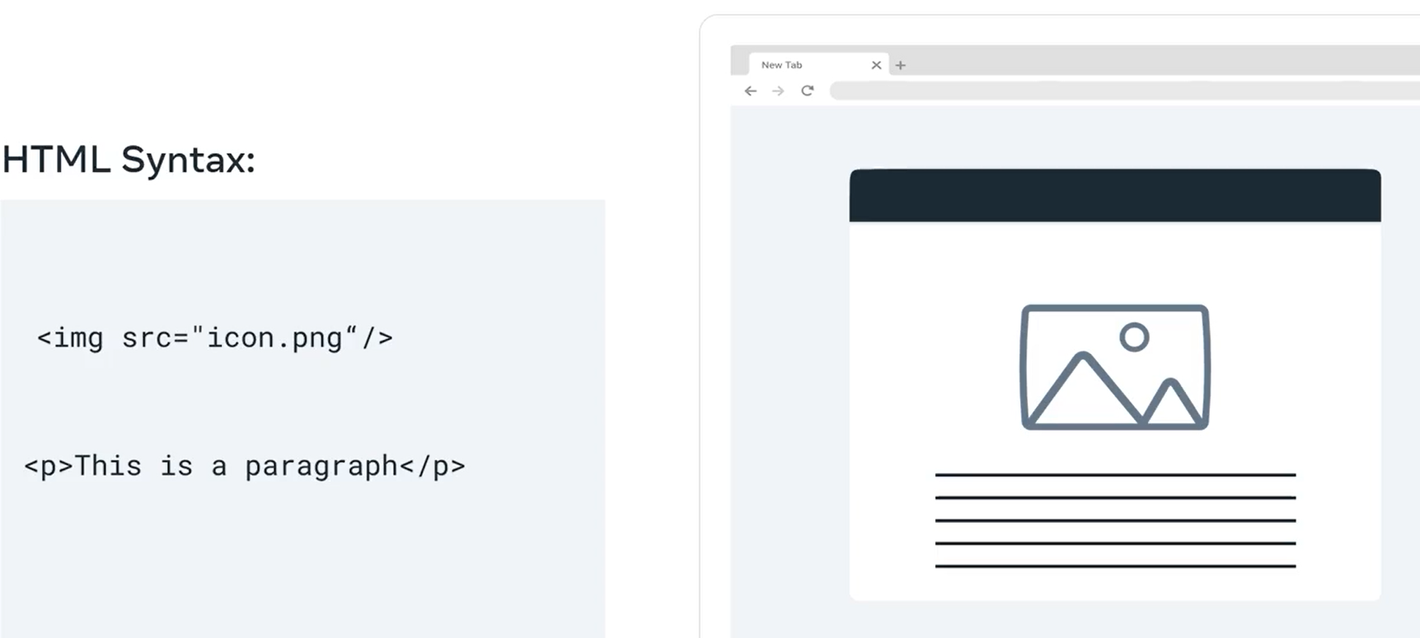
What is HTML?
For example, the browser reads an HTML page that has an image tags display an image file called icon.png.
Next, it reads a p tag to display a paragraph under that image.

Slide 20
What is HTML?
But the browser reads the HTML document and displays the web page to the user in a very basic format.
Now, if you want to tell the browser how to display the web page, you should use CSS.
You will learn more about CSS in this course.

Slide 21
Summary
By now, you have learned how HTML tags are used to create elements that build the structure of a web page.
You'll have an opportunity to explore HTML in action in this course.

Slide 22
Additional Resources
Learn more Here is a list of resources that may be helpful as you continue your learning journey.
HTML Elements Reference (Mozilla)
https://developer.mozilla.org/en-US/docs/Web/HTML/Element
The Form Element (Mozilla)
https://developer.mozilla.org/en-US/docs/Web/HTML/Element/form
What is the Document Object Model? (W3C)
https://www.w3.org/TR/WD-DOM/introduction.html
ARIA in HTML (W3C via Github)
https://w3c.github.io/html-aria/
ARIA Authoring Practices (W3C)
https://www.w3.org/TR/wai-aria-practices-1.2/

Slide 23
Thank You

